Slide 1
LETABA ECOSYSTEM SERVICES
CONSEQUENCES OF SCENARIOS
Presented by:
Greg Huggins
Nomad
03 April 2014

Slide 2
NWRCS integrated steps
1: Delineate units of analysis and describe the status quo
2: Initiation of stakeholder process and catchment visioning
3: Quantify EWRs and changes in Ecosystem Services
7: Gazette class configuration
4: Identification and evaluation of scenarios within IWRM
5: Draft Management Classes
6: Resource Quality Objectives (EcoSpecs & water quality (user))
Ecosystem Services : Where does it fit in?

Slide 3
Ecosystem Services
Ecosystem Services are the goods and services provided by the river (and associated ecological systems) that result in a value being produced for consumers.
Evaluate changes to Ecosystem Services against scenarios in expert workshop that identifies the potential change that each of the key Ecosystem Services may undergo in the each of the scenarios
This is done at a species level for provisioning services or at disaggregated services level for regulating services.
The potential change will be noted as a factor and used in later calculations. For example, no change = 1, a 50% increase = 1.5, and a 20% decrease = 0.8.
These are linked to river reaches.

Slide 4
Scenario Impact
The model is used to combine the various subsets (e.g. species) and rate each of the “categories” i.e. each of provisioning services, cultural services, regulating services, supporting services would then have a summarised rate relative to “1”.
Each of the categories is weighted. This is related to the significance of the impact – driver is often intensity of utilisation/importance of service - and score overall.
Each river reach will have a score per scenario.
The final step is the weight each of the river reach sites relative to each other.

Slide 5
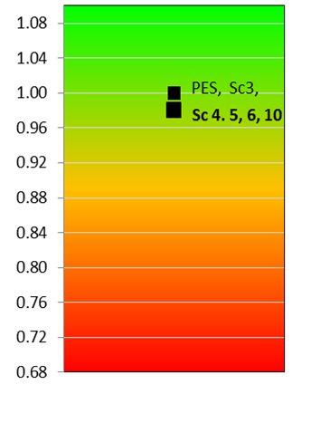
RESULTS PER EWR SITES: EWR 1 (LETABA)
Sc. 3 is similar to the present day although some very marginal improvement in provisioning services.
All other Scenarios have very marginal negative impacts mostly related to regulating services and associated water quality.

Slide 6
RESULTS PER EWR SITES: EWR 3 (LETABA)
Sc 6: Reduced high flows impact Regulating Services in negative manner.
Sc 4, 5, 9: marginal negative impact in some provisioning services and moderate negative for regulating services negative f.
Sc 3: marginal positive impact associated with improved provisioning services.

Slide 7
RESULTS PER EWR SITES: EWR 4 (LETABA)
Scenario 3 has least negative impact. Minor negative impact on regulating services but others remain virtually as per status quo
Sc 6, 9, 10: Reduced flows will impact negatively on the regulating services
Sc 4,5: Regulating services, particularly those associated with waste assimilation and dilution, as well as stream flow regulation were anticipated as being fairly heavily compromised under Sc 4/5

Slide 8
RESULTS PER EWR SITES: EWR 7 (LETABA)
All scenarios were seen as potentially negative.
Regulating services, particularly those associated with waste assimilation and dilution, as well as stream flow regulation were anticipated as being compromised under Sc 4/5 and 6 as well as 9 an10,
Sc 3 has least negative impact. Some provisioning services improve marginally but not enough to translate into overall positive impact

Slide 9
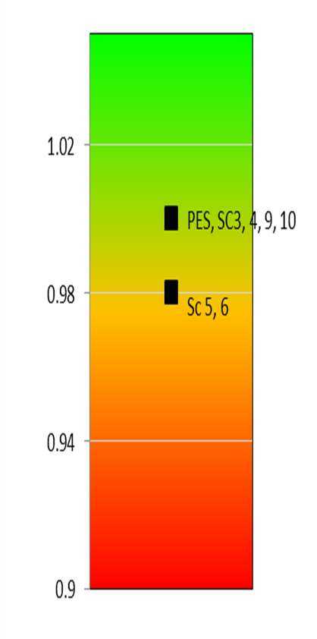
RESULTS PER EWR SITES: EWR 2 (LETSITELE)
Sc 3, 4, 9,10 have virtually no ecosystem services associated impacts.
Sc 5, 6: regarded as being marginally negative. Here the provisioning (mostly fish) and regulating services as well as supporting services were regarded as being negatively impacted but only to limited extent. Some floral species would have a marginally positive impact.

Slide 10
RESULTS PER EWR SITES: EWR 5 (KLEIN LETABA)
Sc 3: Virtually no ecosystem services impacts.
Sc 4,6, 9,10: Reduced flows in the wet season will reduce abundance and suitability of some habitat. Some species associated with provisioning services impacted as well as regulating/cultural services negative impact.
Sc 5: Some provisioning services (fish species) but particularly regulating and cultural services are negatively impacted

Slide 11
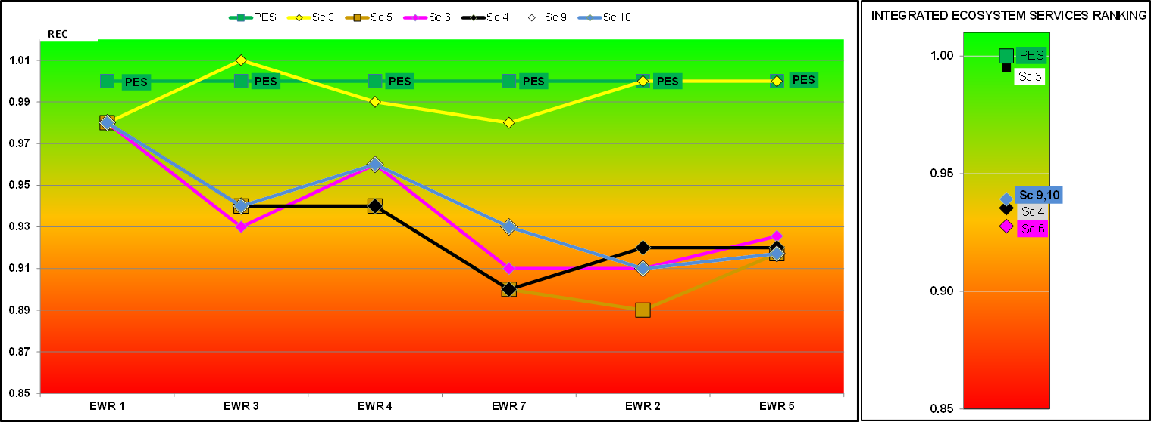
Summary of ranking per reach

Slide 12
Reach Weighting
The final step is the weight each of the river reach's relative to each other – as follows. Reaches associated with EWR 3 scored the highest as they had the greatest numbers of people and broadest range of ecosystem services associated. This was followed by EWR 4. The site is in the Letaba Reserve and includes associated reaches with high significance usage. As linkage to use and associated value falls off so too does the reach weighting
EWR site | SCI | Ecosystem Services Rank | Weight
EWR 1 | Low | 4 | 0.133
EWR 3 | High | 1 | 0.223
EWR 4 | High | 2 | 0.191
EWR 7 | Low | 4 | 0.134
EWR 2 | Moderate | 3 | 0.185
EWR 5 | Low | 4 | 0.134

Slide 13
Ranking for the Letaba system
PES
Sc 3
Sc 9,10
Sc 4
Sc 6

